Slide 1



Inner Bloom
Therapeutic Mental Wellness Through Interactive Puzzle Games
PowerLearnProject - Group 27, February 2025 Cohort
01

Slide 2
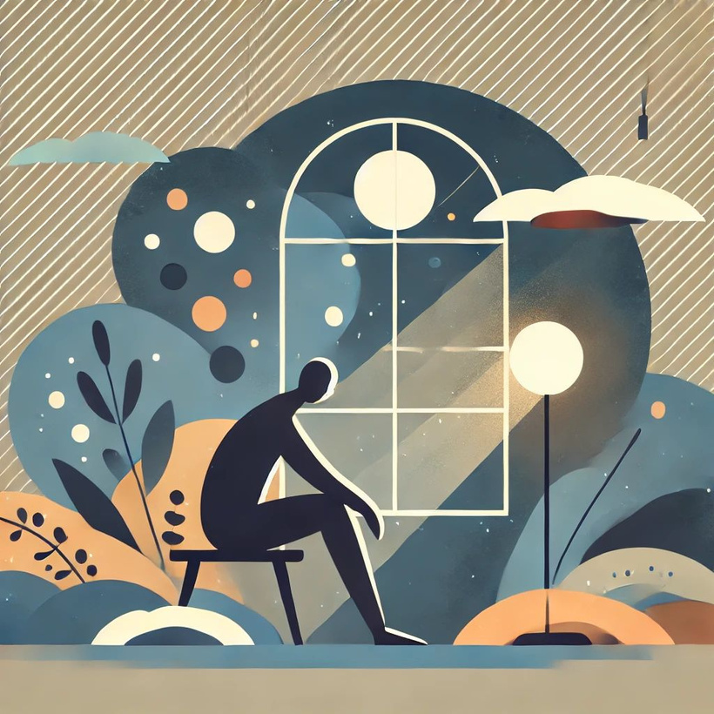
The Mental Health Crisis
• 1 in 5 adults experience mental health issues annually
• Limited access to engaging therapeutic tools
• Traditional therapy can be expensive and intimidating
• Need for accessible, evidence-based wellness interventions
• Lack of interactive, calming digital mental health resources
10

Slide 3

Inner Bloom
Therapeutic Puzzle Platform
• Interactive nature-themed jigsaw puzzles with therapeutic benefits
• AI-powered sentiment analysis for personalized affirmations
• Crisis support resources integrated seamlessly
• Anonymous feedback system respecting user privacy
• Progressive difficulty with calming background music
• Dark mode and full accessibility support
06

Slide 4


What Inner Bloom Does
Core Features:
• Click-to-swap puzzle mechanics with beautiful nature photography
• Positive therapeutic affirmations throughout gameplay
• Multiple ambient sound options (rain, ocean, forest, meditation)
• Crisis support resources readily accessible
• Comprehensive quality assurance and testing framework
Technology Stack:
• Node.js Express server with OpenAI API integration
• Responsive HTML5/CSS3/JavaScript frontend
• Anonymous usage analytics for effectiveness measurement
04

Slide 5



Target Market
Mental Health & Wellness Users
2 out 5
Adults report increased stress and anxiety levels
75%
Of people prefer digital wellness tools they can access privately
450 million
People worldwide affected by mental health conditions
14

Slide 6
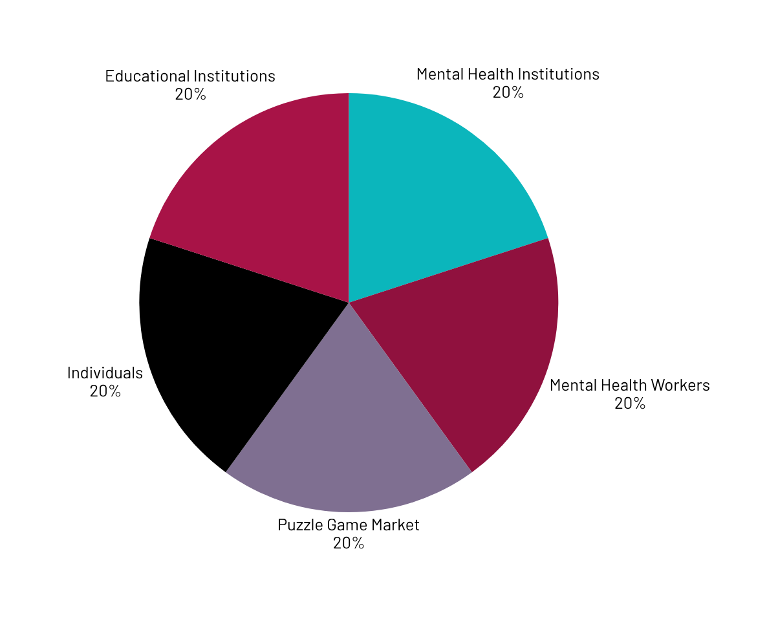
Digital Mental Health Market
Primary Market: Individual wellness seekers
Secondary Market: Mental health professionals recommending digital tools
Tertiary Market: Educational institutions and wellness programs
• Digital mental health market valued at $5.6 billion (2023)
• Expected 23.6% annual growth rate
• Puzzle game market: $15 billion globally
• Increasing demand for accessible mental health solutions

Slide 7
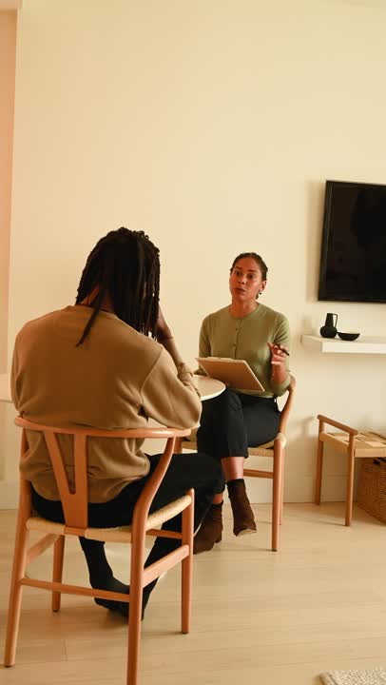
Competitive Landscape
Direct Competitors:
• Headspace, Calm (meditation apps)
• Flow Free, Monument Valley (puzzle games)
Indirect Competitors:
• Traditional therapy platforms
• General wellness applications
Why We're Different:
•Combines therapeutic benefits with engaging puzzle gameplay
• Professional-grade crisis support integration
• AI-powered personalization without compromising privacy
• Designed specifically for clinical recommendation
23

Slide 8

What Makes Inner Bloom Unique
• Therapeutic Focus: Evidence-based design for mental wellness
• Privacy-First: Anonymous usage tracking, no personal data collection
• Professional Integration: Documentation for mental health professionals
• Comprehensive Testing: Advanced QA framework ensuring reliability
• Accessibility: Full keyboard navigation and screen reader support
• Crisis Safety: Integrated emergency mental health resources

Slide 9
Project Traction: Development Timeline
Tasks
Month 1
Month 2
Month 3
Month 4
Month 5
Core puzzle mechanics
Therapeutic features
AI integration
Testing framework
Accessibility features
Crisis support integration
Quality assurance system
Deployment & documentation
23

Slide 10

Business Model
Current Phase: Open-source educational project
Future Monetization Options:
• Freemium model with premium puzzle content
• Licensing to mental health institutions
• Professional training modules for therapists
• Corporate wellness program partnerships
Value Proposition:
• Reduced therapy costs through supplemental digital tools
• Improved patient engagement between sessions
• Measurable wellness outcomes through analytics
23

Slide 11
Go To Market: Customer Acquisition Strategy
Phase 1: Clinical Validation
• Partner with mental health professionals for feedback
• Implement in university counseling centers
• Gather effectiveness data and testimonials
Phase 2: Digital Distribution
• App store deployment with SEO optimization
• Mental health blog partnerships and content marketing
• Professional conference presentations
Phase 3: Institutional Adoption
• Healthcare system partnerships
• Corporate wellness program integration
• Educational institution licensing

Slide 12
Social Impact: UN Sustainable Development Goals Addressed
SDG 3: Good Health and Well-being
• Promotes mental health through accessible therapeutic tools
• Reduces barriers to mental wellness resources
SDG 4: Quality Education
• Educational project demonstrating health technology innovation
• Teaches responsible AI integration in healthcare
SDG 10: Reduced Inequalities
• Free access removes economic barriers to mental health support
• Accessibility features ensure inclusive design
SDG 17: Partnerships for Goals
• Collaboration between technology and mental health sectors

Slide 13
Technical Achievements: Development Excellence
Comprehensive Feature Set:
• 9 different puzzle configurations with nature photography
• OpenAI API integration for sentiment analysis
• Real-time quality assurance monitoring
• Professional testing dashboard with 20+ automated tests
Technical Highlights:
• Node.js server with Express.js framework
• Responsive design supporting all device sizes
• WCAG accessibility compliance
• Anonymous usage analytics respecting privacy
• Crisis resource integration with emergency contacts

Slide 14
Our Ask: Project Completion & Next Steps
Current Status:
• Fully functional therapeutic puzzle application
• Comprehensive testing and quality assurance framework
• Professional documentation for clinical use
• Successfully deployed with health monitoring
What We're Seeking:
• Academic recognition for innovative health technology solution
• Feedback from mental health professionals for future iterations
• Potential partnerships with educational or healthcare institutions
• Continued development support for enhanced feature

Slide 15

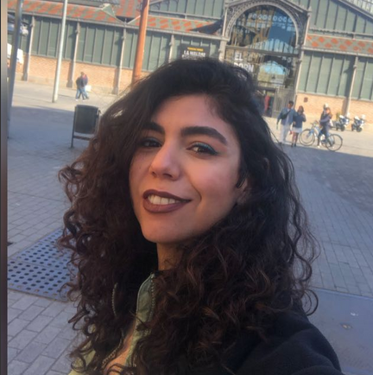


Development Team
PowerLearnProject - Group 27, February 2025 Cohort
ANNGLADYS GICHUHI
AMANY NABIL MOHAMED
THERECIA NDANU
TRACEY MUNGE
Original Creator & Project Owner
Project Lead, Review & Adaptation
Testing, Pitch Deck, & Review
Testing, Pitch Deck, & Review

Slide 16



Thank you!
https://github.com/anngladys
https://github.com/amanynmohamed
https://github.com/thereciandanu
https://github.com/traceeey
17

